Slide 1
Expression Tree
Infix, Postfix and Prefix

Slide 2
Expression Tree
What is the ordered rooted tree that represents the expression
((x + y)↑2) + ((x − 4)/3)?

Slide 3
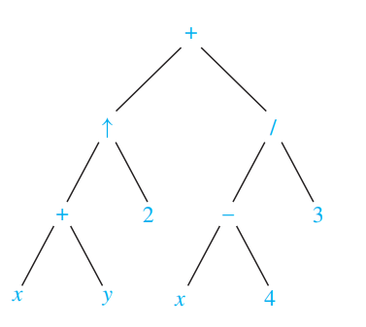
Expression Tree
What is the ordered rooted tree that represents the expression
((x + y)↑2) + ((x − 4)/3)?

Slide 4
More Expression Trees
What are the ordered rooted tree that represent the expressions
(x+y)/(x+3)
(x+(y/x))+3
x+(y/(x+3)))

Slide 5
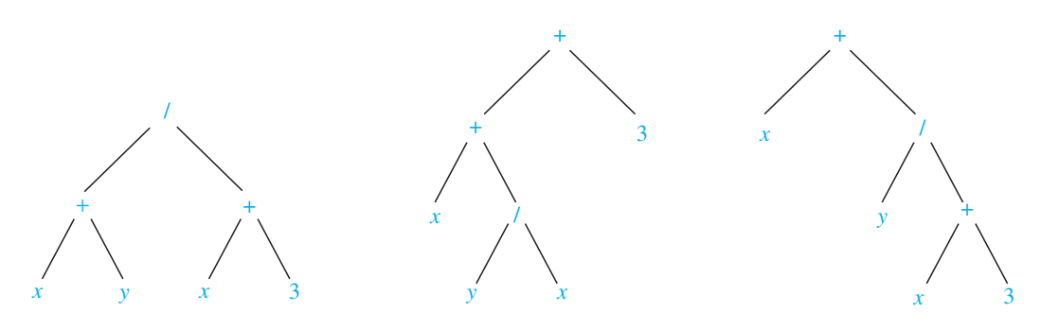
More Expression Trees
What are the ordered rooted tree that represent the expressions
(x+y)/(x+3)
(x+(y/x))+3
x+(y/(x+3)))

Slide 6
More Expression Trees
What are the ordered rooted tree that represent the expressions
(x+y)/(x+3)
(x+(y/x))+3
x+(y/(x+3)))
Different Trees Same In Order

Slide 7
More Expression Trees
What are the ordered rooted tree that represent the expressions
(x+y)/(x+3)
(x+(y/x))+3
x+(y/(x+3)))
Different Trees Same In Order
Insert Parenthesis for the Operators

Slide 8
Determining Prefix and Postfix
We just saw how to determine in order traversal.
Let us try out postorder and preorder
Find the prefix and postfix form for ((x+y)^2)+((x-4)/3)

Slide 9
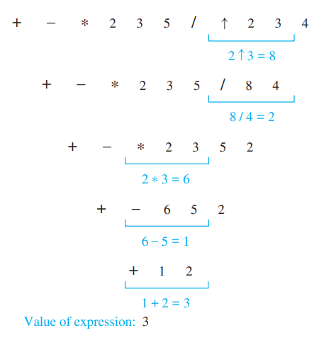
Evaluating Prefix Expressions
What is the value of the prefix expression +−∗ 235/↑ 2 3 4?

Slide 10
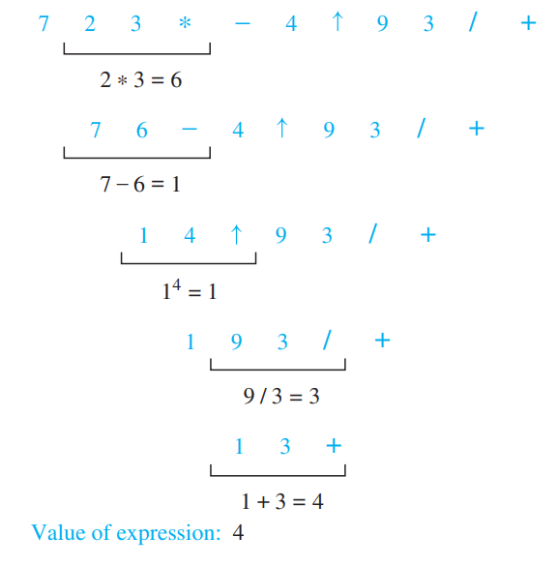
Evaluating Prefix Expressions
What is the value of the postfix expression 723 ∗ − 4 ↑ 9 3/+?

Slide 11
Unary Operator
Find the ordered rooted tree representing the compound proposition (¬(p ∧ q)) ↔ (¬p ∨ ¬q). Then use this rooted tree to find the prefix, postfix, and infix forms of this expression.

Slide 12
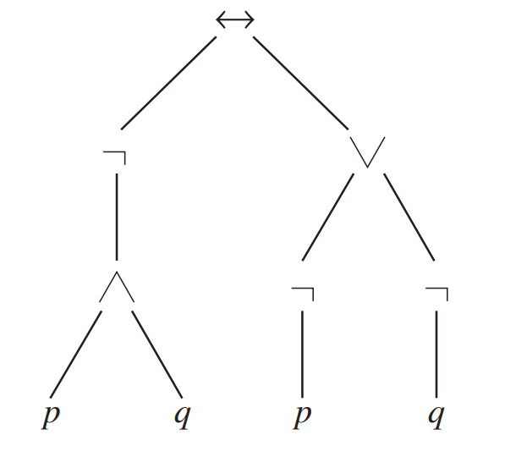
Unary Operator
Find the ordered rooted tree representing the compound proposition (¬(p ∧ q)) ↔ (¬p ∨ ¬q). Then use this rooted tree to find the prefix, postfix, and infix forms of this expression.

Slide 13
Unary Operator
Find the ordered rooted tree representing the compound proposition (¬(p ∧ q)) ↔ (¬p ∨ ¬q). Then use this rooted tree to find the prefix, postfix, and infix forms of this expression.

Slide 14
Unary Operator
Determine the prefix and postfix
(5+1)!+2*3/2+(8+2)
Evaluate the prefix and postfix notations

Slide 15
Thank You

